Slide 1


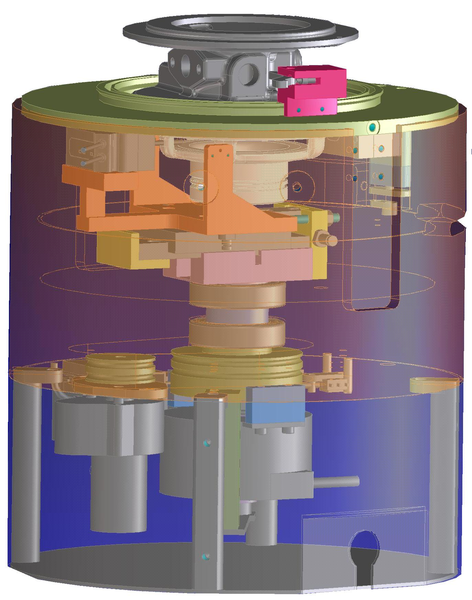
"SHERLOCK"
Check Vanes device
Premessa
Progetto
Futuri up-grade
IMMAGINI
STOP

Slide 2
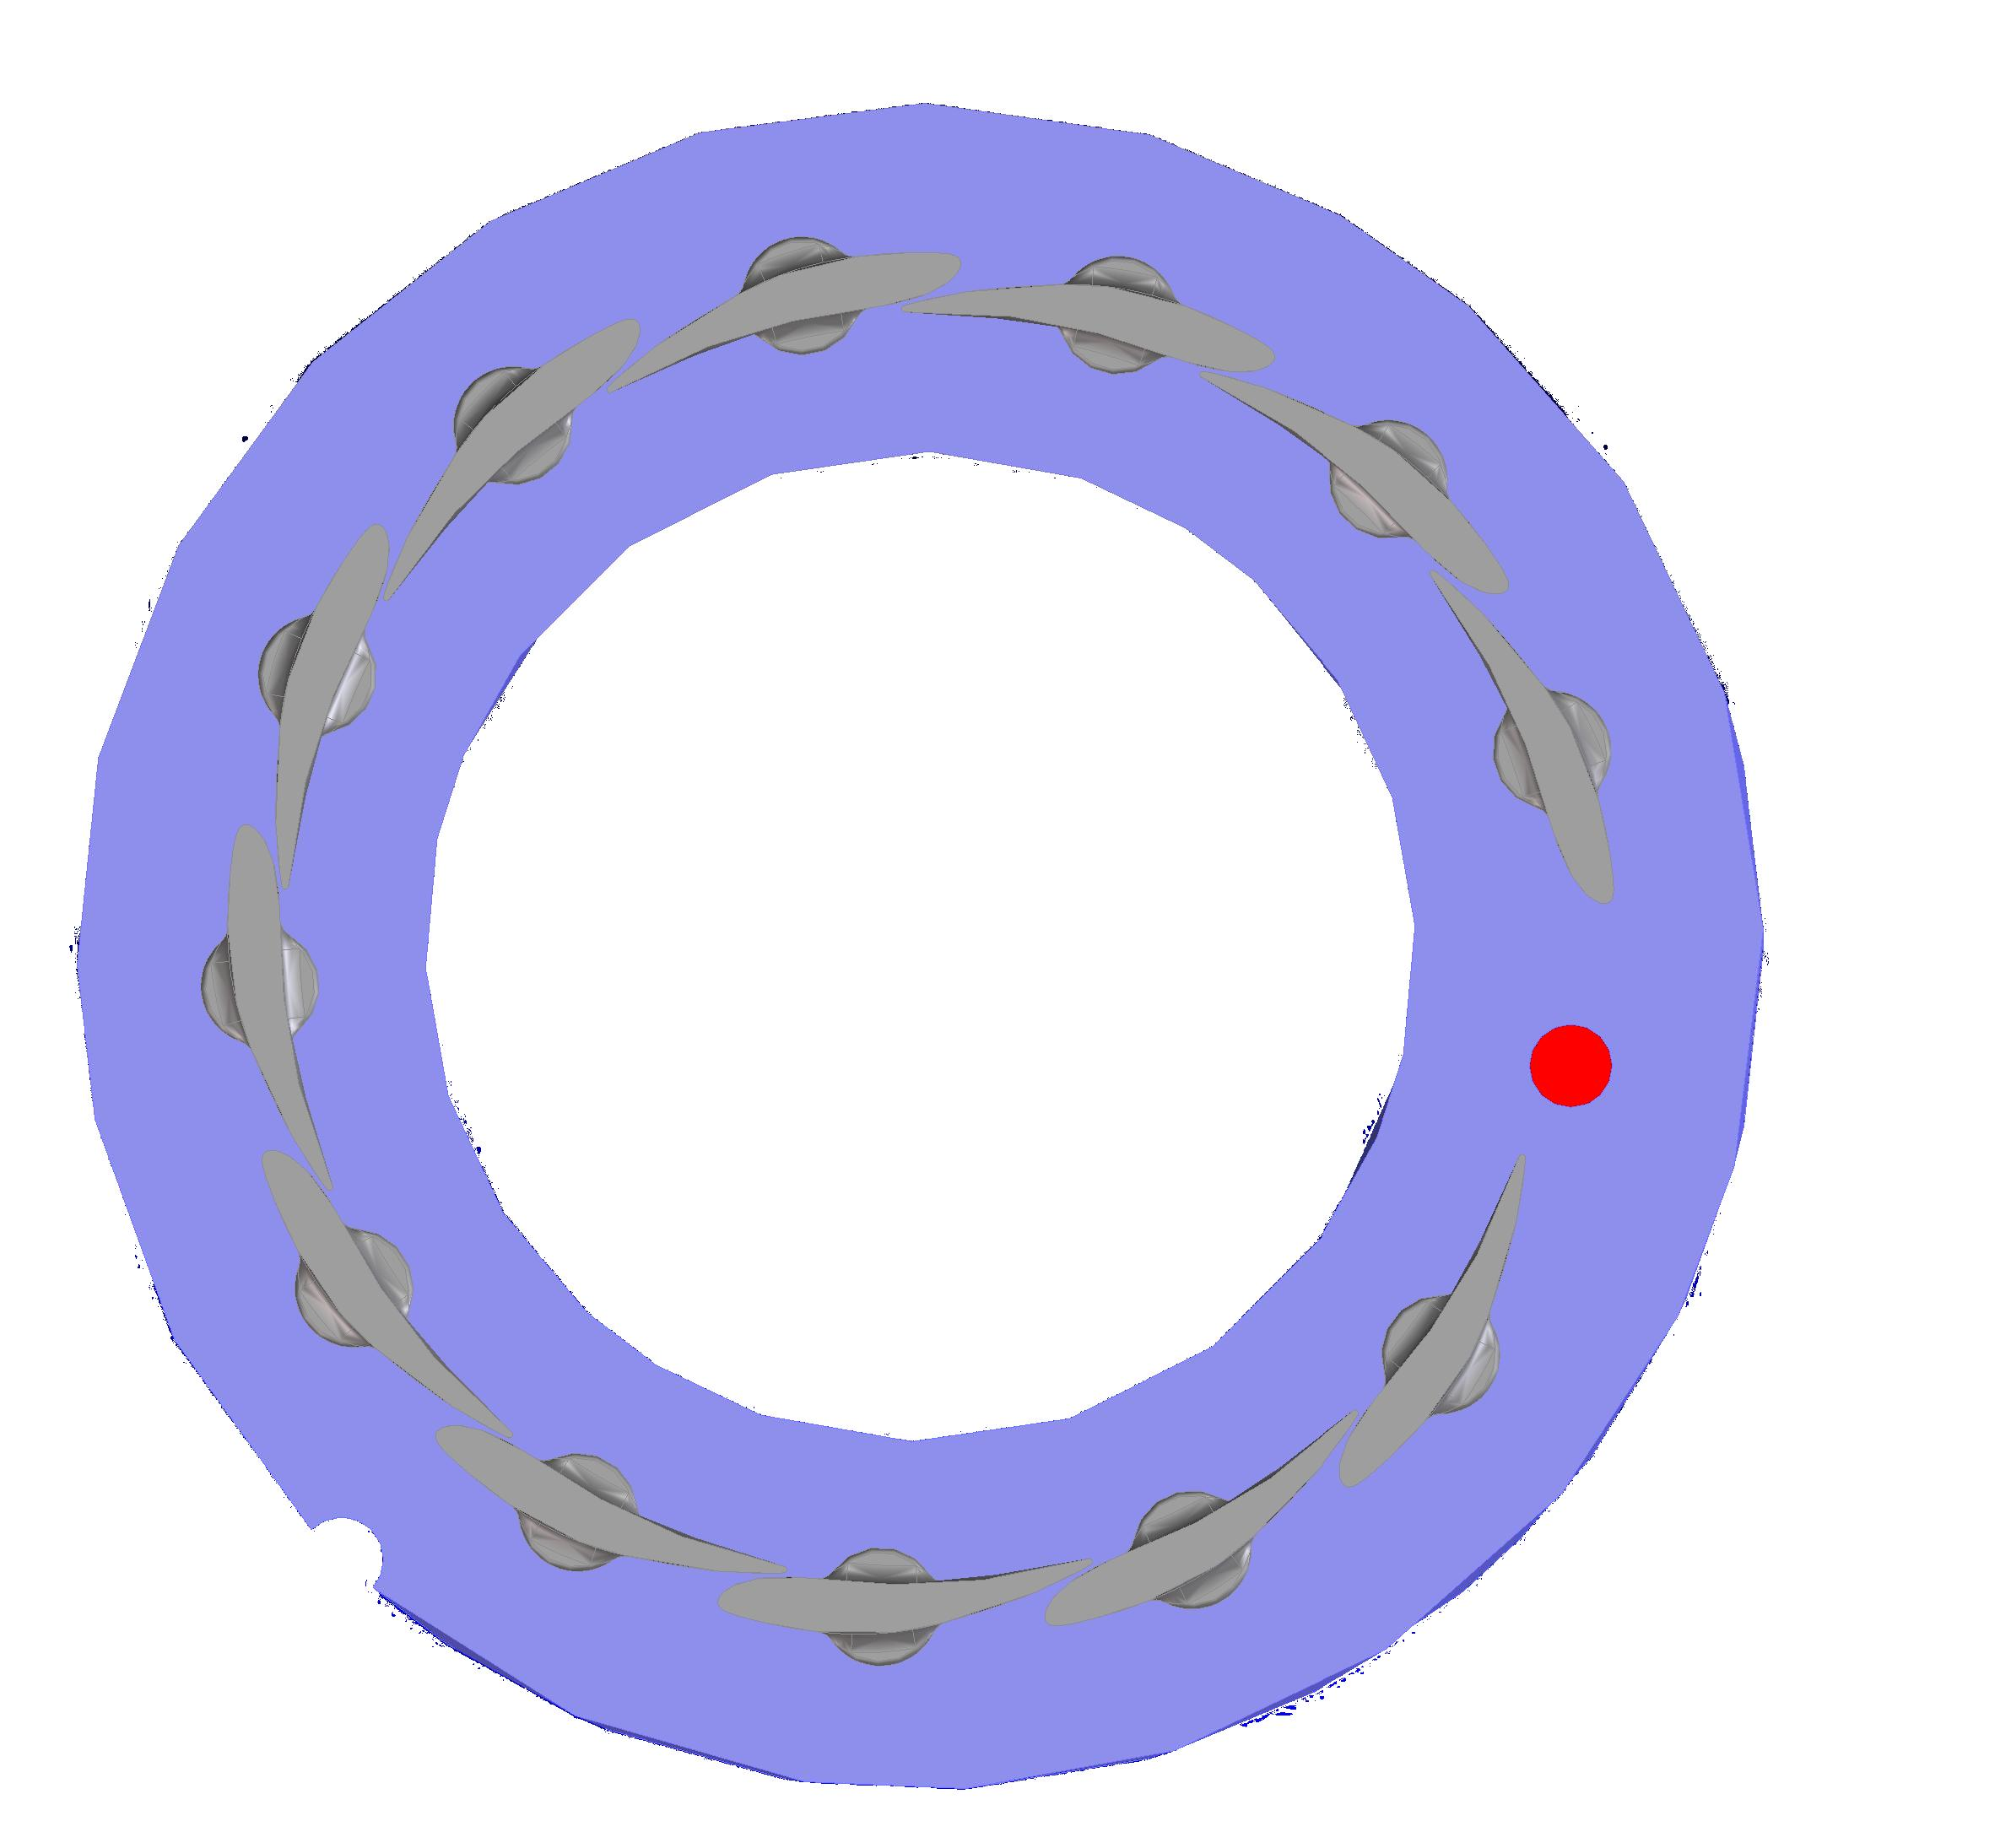
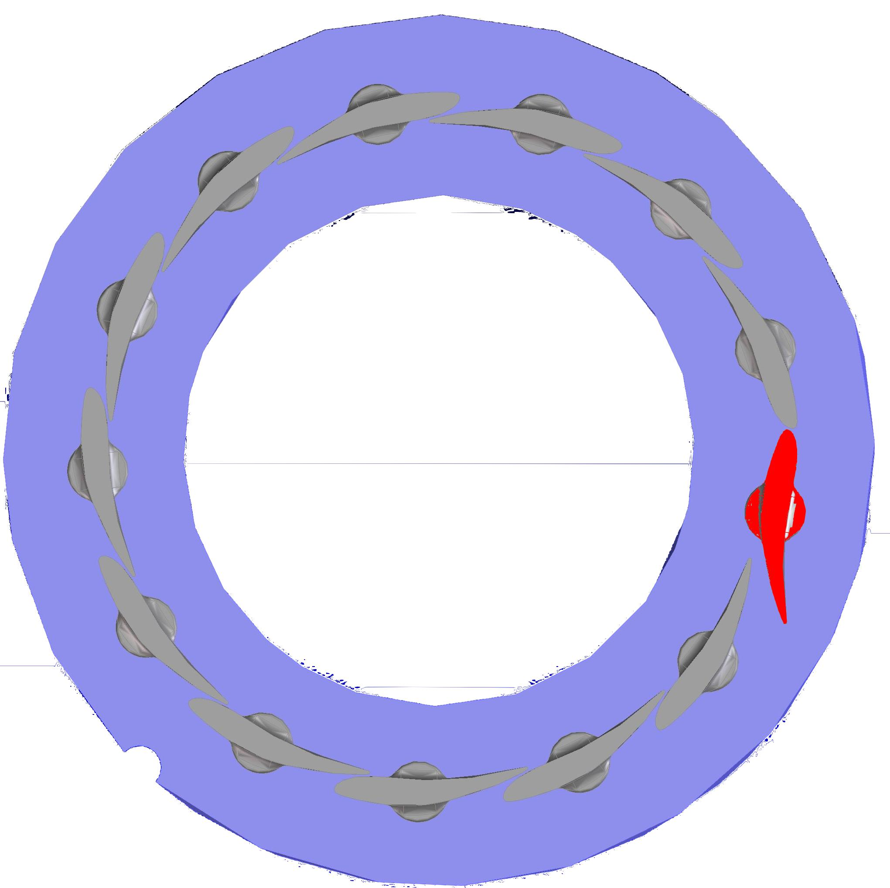
PREMESSA
“Sherlock” is a specific device to check presence and position of vanes inside pre-assembled sub-assy
CHRA-Nozzle-Insert.
STOP

Slide 3
PROGETTO
Sherlock includes a special holder for CHRA and a motorized holder for the sensors.
CRANCK BLOCKING SYSTEM
LASER FOR RADIAL CHECK
SENSOR TO CHECK CHRA PRESENCE
SLIDE
OPTICAL SENSOR FOR TANGENTIAL CHECK
ROTATION LIMIT SWITCH
MOTOR
ENCODER
STOP

Slide 4
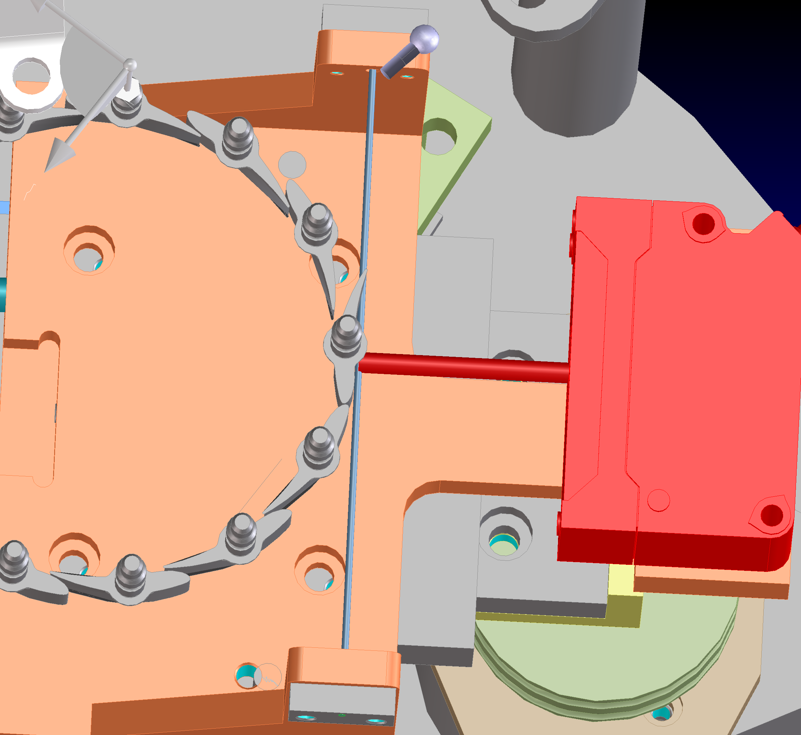
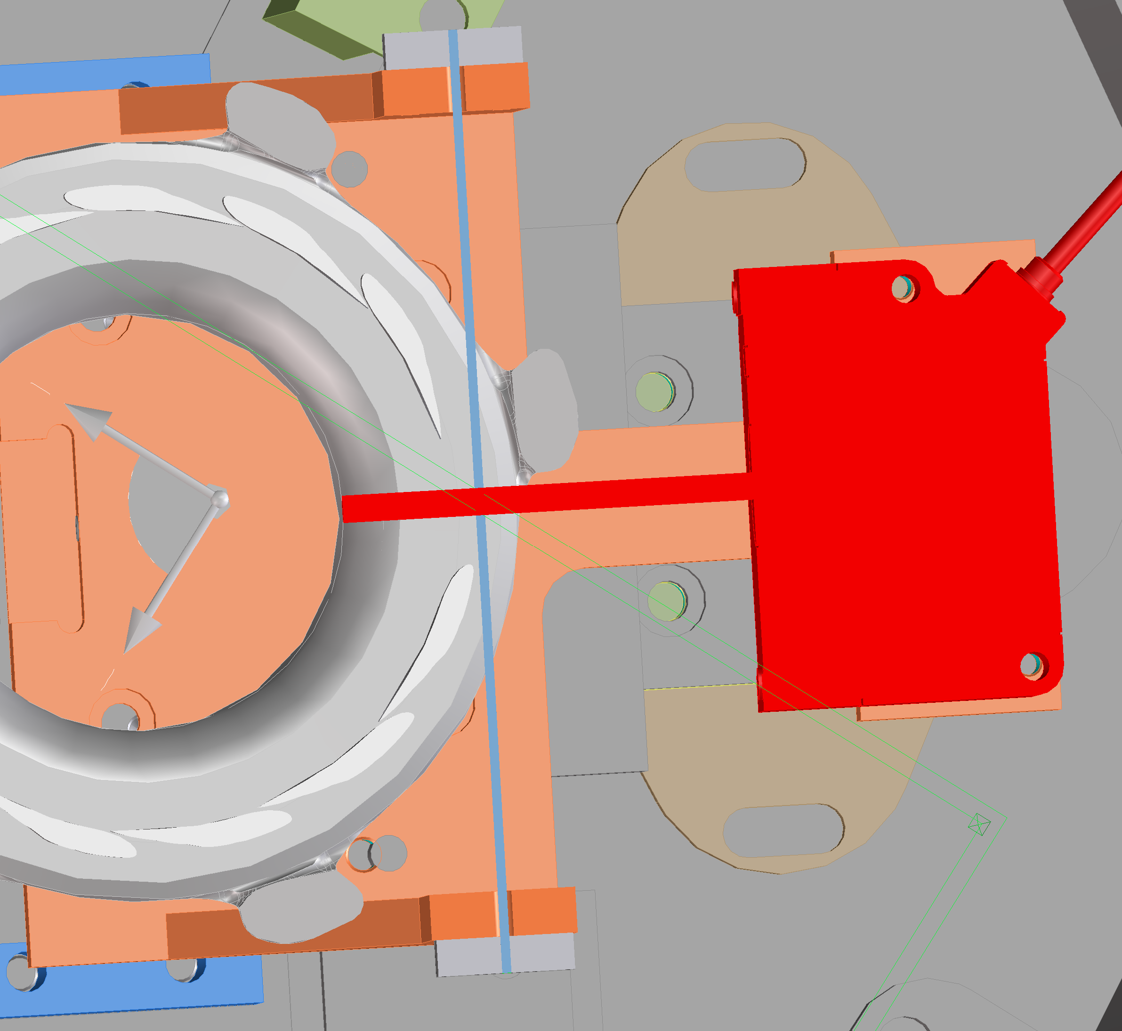
PROGETTO
OPTICAL SENSOR FOR TANGENTIAL CHECK
Sensors
LASER SENSOR FOR RADIAL CHECK
IT ASSURES DETECTION OF BAD POSITIONED VANES
IT ASSURES DETECTION OF MISSING VANES
STOP

Slide 5
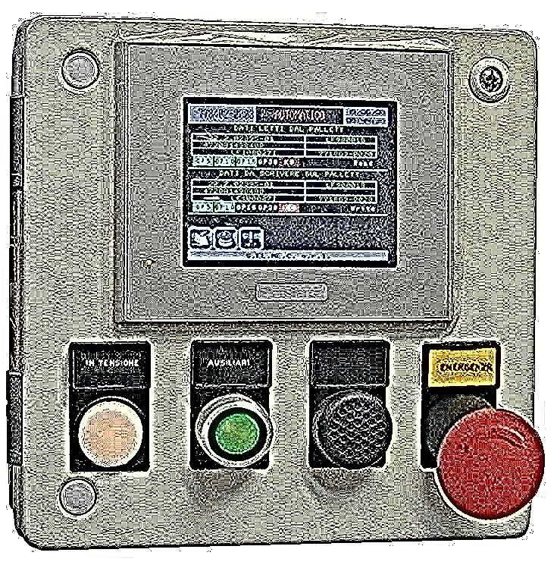
FUTURE UP-GRADE
NEW
Stand-alone system
THE “CONTROLLER OPTION” IS AN INTERFACE THAT WILL ALLOW THE STAND ALONE USABILITY OF THE DEVICE:
THE STAND ALONE SYSTEM WILL BE CAPABLE OF BE CONNECTED TO THE 1ST ORIENTATION BENCH, SENDING THE RESULT OF THE TEST ( “OK” / “NON OK”)
PLC - HMI
ADVANTAGES OF THE STAND ALONE SOLUTION:
INSTALLATION TIMES NOT DEPENDING ON BENCH COPLEXITY
NO MODIFICATION OF THE BENCH
THE DEVICE CAN BE TESTED OUTSIDE THE BENCH (ONLY 24Vdc NEEDED)
AVAILABLE CONNECTIONS ETHERNET AND P-DP
EASY REPLACEMENT IN CASE OF FAILURE
STANDARD CONNECTION ANYWAY POSSIBLE
STOP

Slide 6
END OF PRESENTATION
STOP

